Slide 1
Machine Learning with Python
The Complete Course
TELCOMA

Slide 2
Module 3 Exploratory Data Analysis Feature Engineering & Hypothesis Testing

Slide 3
Content:
Overview of the Machine Learning methodology
Exploratory Data Analysis (EDA)
Univariate & Bivariate Analysis
Feature Engineering
Introduction to Statistics
Statistical Inference, Probability Distributions
Hypothesis Testing

Slide 4
Machine Learning Methodology
Identify Problem
Define the problem statement and the end outcome expected
Gather Data
Identify, Collect and prepare data available for the use case
Perform EDA, Build features
Explore, analyze and study the length and depth of data
Build Machine Learning Models
Train and develop machine learning models for the use case
Productionize solution
Develop data products, deploy automated solutions

Slide 5
Exploratory Data Analysis
Definition
EDA i.e. Exploratory Data Analysis is the process of studying data by leveraging various statistical and visualization techniques.
Univariate Analysis
It is the process of exploring a single variable or attribute at a time. It doesn’t explain relationships or causes for a pattern
Bivariate analysis
It involves the analysis of two variables at a time to determine the empirical relationship between them.
Multivariate analysis
It involves the analysis of more than one variable at a time.

Slide 6
Univariate Analysis
Categorical Attribute
Numeric Attribute
Visualization Technique | Statistic | Definition
Bar Chart | Count | The number of values of the specified variable.
Pie Chart | Count% | The percentage of values of the specified variable.
Visualization Technique | Statistic | Definition
Box Plot | Minimum | The min value from all the observations
 | Maximum | The max value from all the observations
 | Mean | Average or the sum of values divided by the number of observations
 | Median | The middle value. Below and above the median lies equal number of observations.
 | Range | The difference between maximum and minimum.
 | Quantile | A set of 'cut points' that divide a set of data into groups containing equal numbers of values
Histogram | Variance | A measure of data dispersion.
 | Standard Deviation | The square root of variance.
 | Coefficient of Deviation | A measure of data dispersion divided by mean.
 | Skewness | A measure of symmetry or asymmetry in the distribution of data.
 | Kurtosis | A measure of whether the data are peaked or flat relative to a normal distribution.

Slide 7
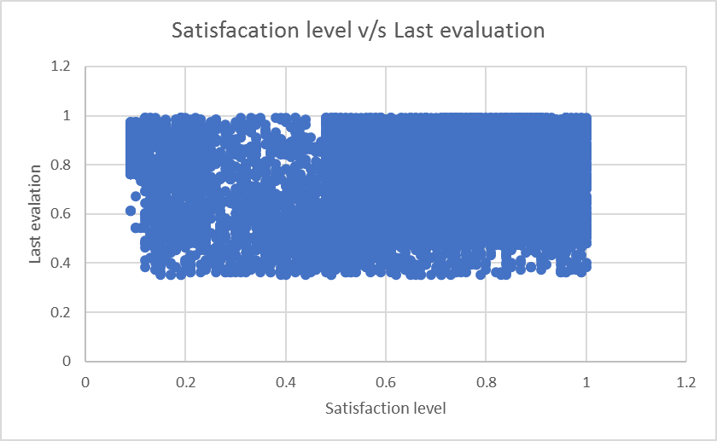
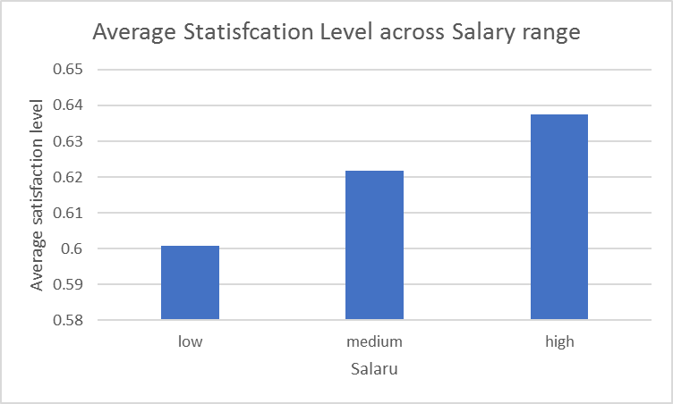
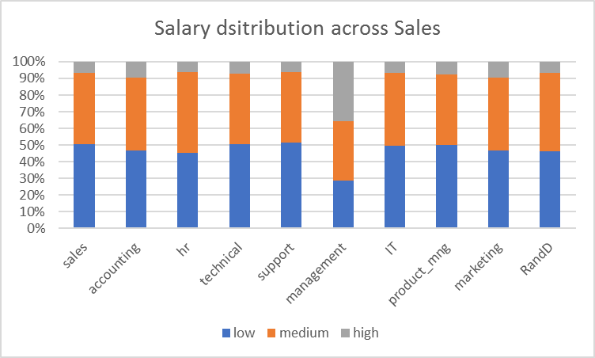
Bivariate Analysis
Numerical & Numerical
Numerical & Categorical
Categorical & Categorical
Scatter plots
Defines the correlation between the two numeric variables
Bar Charts
The bar chart is used to showcase the average values of the numeric attribute across different classes of the categorical attribute
Stacked Bar Chart
The Stacked bar/column chart compares the percentage that each category from one attribute contributes to a total across categories of the second variable.

Slide 8
Demo

Slide 9
Feature Engineering
Raw Data
Feature Engineering
Definition
Feature Engineering is the process of leveraging domain expertise to create features that help machine learning algorithms work better.
The process is difficult and expensive.
Alternatively,
Feature engineering is the science of extracting more information from existing data.
This newly extracted information can be used as input to our prediction model.
Few techniques
Pair wise differences
Log transformation
Square/Cube of the attribute
Pairwise products
Reducing noise in category level

Slide 10
Introduction to Statistics

Slide 11
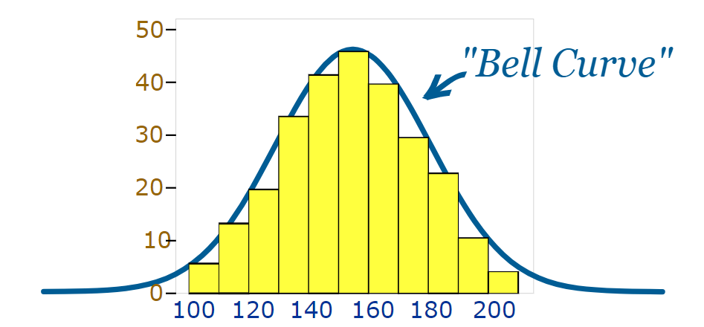
Basics
Measure of Central Tendency
- Mean
- Median
- Mode
The Normal Distribution
Symmetric around the mean, unimodal and asymptotic
Mean = Median = Mode
Completely determined by mean and Standard Deviation
Measure of Variability
- Range
- Variance
- Standard Deviation

Slide 12
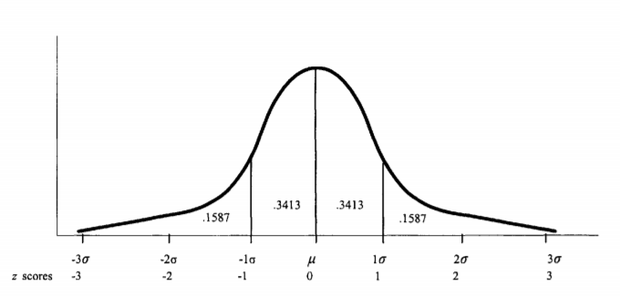
Basics contd..
Z Scores
Central Limit Theorem
The central limit theorem (CLT) is a statistical theory that states that given a sufficiently large sample size from a population with a finite level of variance, the mean of all samples from the same population will be approximately equal to the mean of the population.
Furthermore, all of the samples will follow an approximate normal distribution pattern, with all variances being approximately equal to the variance of the population divided by each sample's size.
Standard Error
Defined as the standard deviation of the sampling of a statistic.
e.g.
Sampling distribution of mean

Slide 13
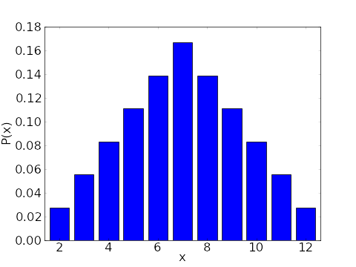
Probability Distributions
Example 1
In the case of rolling a fair die, let X denote the number of dots. X is a discrete random variable.
Let x denote the number of dots observed.
There are 6 possibilities: 1, 2, 3, 4, 5 and 6.
The probability distribution is Pr(x) = 1/6 for all x.
Some pre-requisites
Random variable It is the numerical measurement of the outcome of an experiment that can assume different values at random. A random variable can be discrete or continuous.
Categorical Random Variable e.g. Gender of a baby (male, female)
Numeric random variable assumes any values in an interval. e.g. Body weight
The probability distribution of a discrete random variable assigns a probability to each possible separate value.
Each probability falls between 0 and 1 inclusive,
and the sum of the probabilities of all possible values equals 1
Example 2 – The probability distribution for the sum of 2 six-sided dice

Slide 14
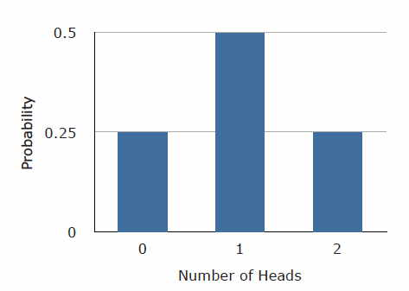
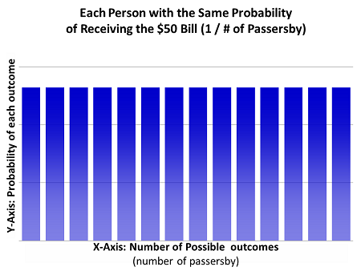
Other important Pr. Distributions
Binomial Distribution
Normal Distribution
Very common numeric probability distribution
Uniform Distribution

Slide 15
Hypothesis Testing
A statistical hypothesis is an assumption about a population parameter.
This assumption may or may not be true.
The goal is to either accept or reject the null hypothesis.
H0 - Null Hypothesis H1 – Alternate Hypothesis
Steps
Set up Hypothesis (NULL and Alternate)
Set the Criteria for decision
Compute the random chance of probability
Take a decision

Slide 16
Demo

Slide 17
Next Module : Machine Learning

